Slide 1
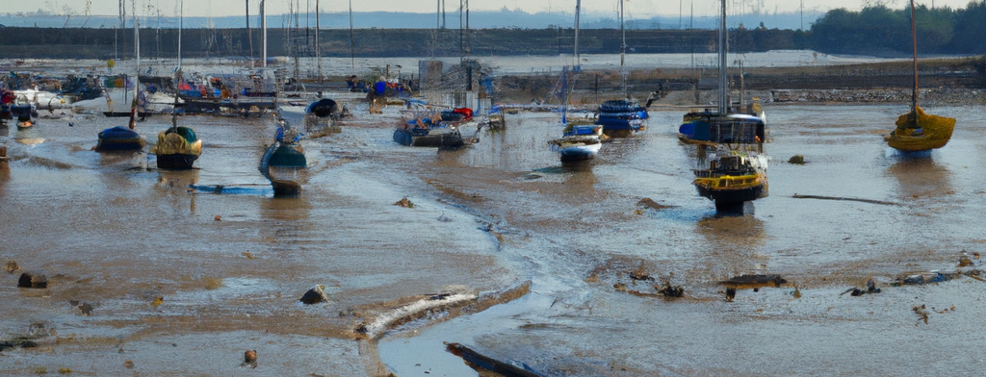
Operation Rising Tide
Mr. Gordon Banks
MAJ Kirk Shoemaker
Defense Threat Reduction Agency
Cognitive disability accommodations
for the Federal workforce
14 June 2023
APPROVED FOR PUBLIC RELEASE
Notes:
Image Source: Generated by Gordon Banks with the assistance of DALL-E (https://openai.com/product/dall-e-2). DALL-E terms of service grant use of generated content for any purpose.

Slide 2
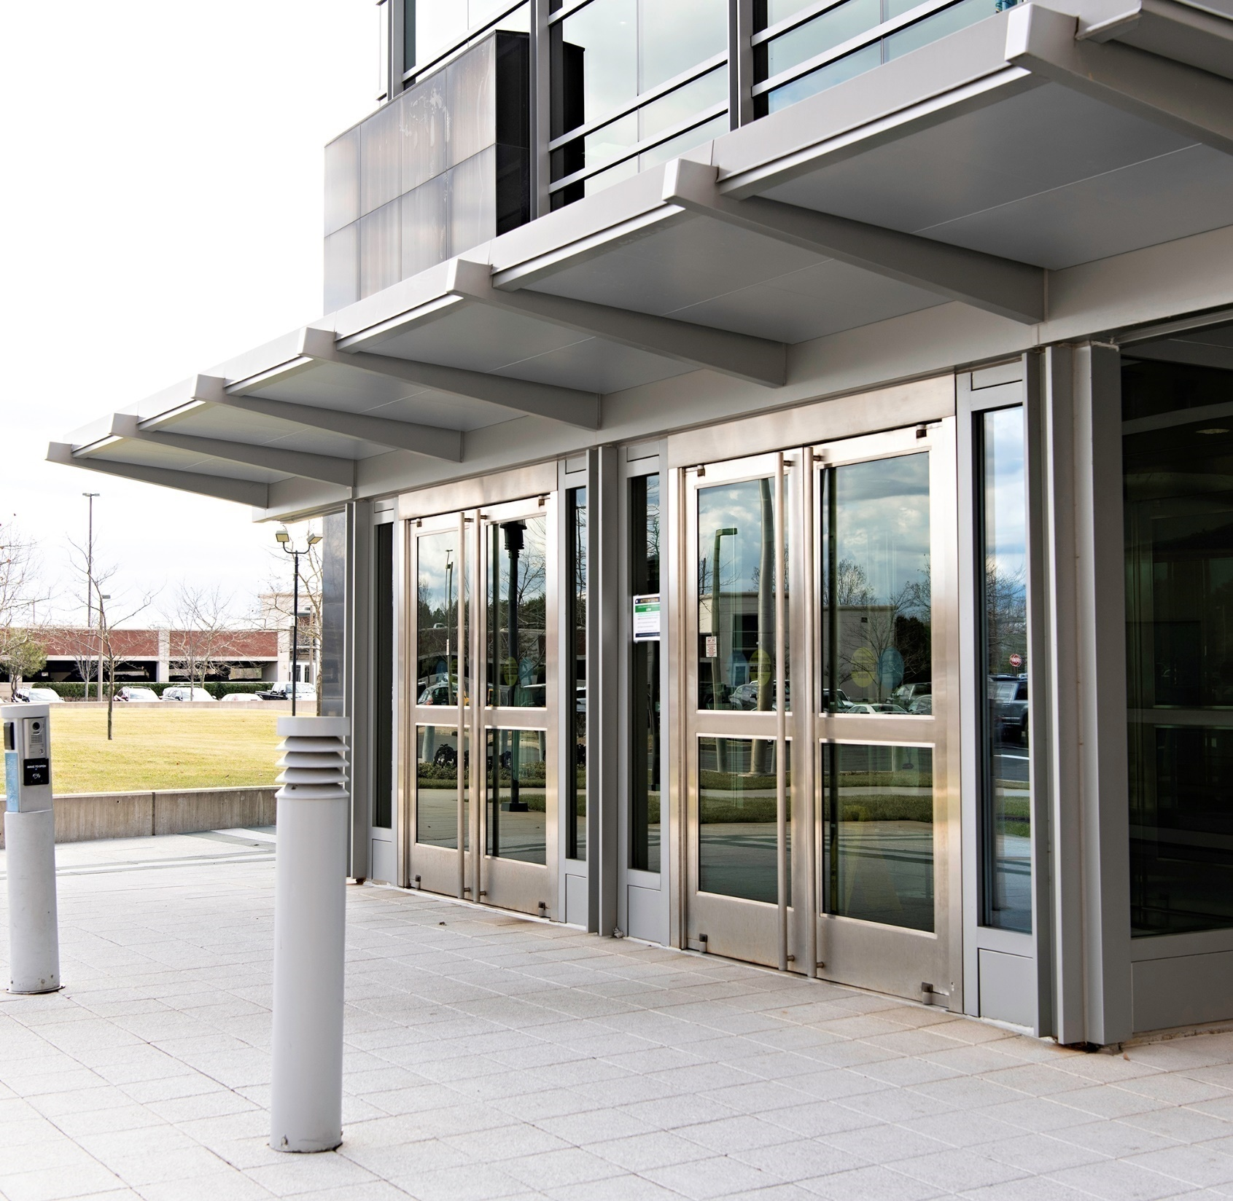
Disability Accommodations Open Doors for Everyone
2
Notes:
Image Source: Defense Threat Reduction Agency.
Doors to the Defense Threat Reduction Agency. These doors are heavy and cumbersome so most people use the automatic door openers even though they are slow.
Wouldn’t be available without legislation requiring accessibility by individuals with physical disabilities
Benefits individuals with and without disabilities
Individuals without disabilities can still determine that the doors have poor usability
Highlight the need to observe a system being used to ensure it meets the design intent

Slide 3
Hypothesis
People with cognitive disabilities have greater difficulty navigating complicated systems than those without such disabilities
Existing policies for disability accommodations can be used to improve Government systems and increase productivity and morale for everyone.

Slide 4
Functional needs: Cognitive & learning disabilities
Functional need (Use with limited…) | Example disabilities with these needs
Attention | Attention Deficit (Hyperactivity) Disorder
Language and Literacy | Aphasia, Dyscalculia
Learning | Brain Injury, Dyslexia
Memory | Age Related Forgetfulness, Mild Cognitive Impairment, ADHD
Executive | Brain Injury, Autism, ADHD
Mental Health | Anxiety, Post Traumatic Stress Disorder
[Adapted from Designing for People with Cognitive Disabilities (and Everyone Else), Rachael Bradley Montgomery, PhD, Digital Accessibility Architect, Library of Congress]
Notes:
[Adapted from Designing for People with Cognitive Disabilities (and Everyone Else), Rachael Bradley Montgomery, PhD, Digital Accessibility Architect, Library of Congress]

Slide 5

Related situational or temporary disabilities
Fatigue
Stress
Distraction
Using jargon, foreign language, or unconventional measurements
Having a human brain
[Adapted from Designing for People with Cognitive Disabilities (and Everyone Else), Rachael Bradley Montgomery, PhD, Digital Accessibility Architect, Library of Congress]
Notes:
[Adapted from Designing for People with Cognitive Disabilities (and Everyone Else), Rachael Bradley Montgomery, PhD, Digital Accessibility Architect, Library of Congress]
Image Source: Elisa Ventur

Slide 6
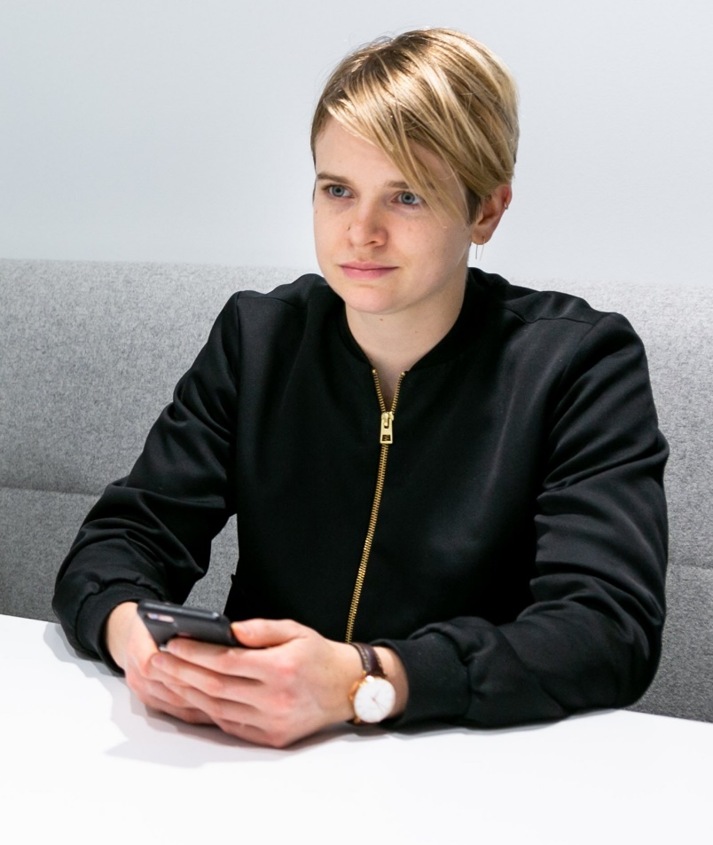
Tal: Contract specialist with dyslexia, impaired eye hand coordination
Problem: It takes me ages to manually enter information into our acquisition system. I often misinterpret fields or select wrong parameters because they are difficult to differentiate.
Works well: The contracting system automatically restricts what can be selected based on prior inputs.
Sample User Needs:
Make it easy to find the most important tasks and features of the site
Make it easy to find the most important actions and information on the page
Provide a login that does not rely on memory or other cognitive skills
[Adapted from Designing for People with Cognitive Disabilities (and Everyone Else), Rachael Bradley Montgomery, PhD, Digital Accessibility Architect, Library of Congress]
Notes:
[Adapted from Designing for People with Cognitive Disabilities (and Everyone Else), Rachael Bradley Montgomery, PhD, Digital Accessibility Architect, Library of Congress]
Image Source: mapbox on unsplash

Slide 7

Jonathan: Supervisor with dyscalculia
Problem: My employee’s time sheet says they started at 0845 today and ended at 1645. Did they work 8 hours?
Works well: Fields that automatically display calculation results. Numerical values in a format that can be easily copy/pasted.
Sample User Needs:
Provide alternatives for numerical concepts
Automatically calculate number values when possible
[Adapted from Designing for People with Cognitive Disabilities (and Everyone Else), Rachael Bradley Montgomery, PhD, Digital Accessibility Architect, Library of Congress]
Notes:
[Adapted from Designing for People with Cognitive Disabilities (and Everyone Else), Rachael Bradley Montgomery, PhD, Digital Accessibility Architect, Library of Congress]
Image Source: Roland Samuel on unsplash

Slide 8

Amy: Autistic computer scientist
Problem: Sometimes people use lots of words on web site links that do not seem to make sense. I think they are metaphors, but I’m not sure.
Works well: I put my mouse over items I do not understand and there is some clear text that explains what it did. I would rather they use clear text in the first place then at least I can use it.
Sample User Needs:
Separate each instruction
Use white spacing
Ensure foreground content is not obscured by background
Use Literal Language
Explain Implied Content
[Adapted from Designing for People with Cognitive Disabilities (and Everyone Else), Rachael Bradley Montgomery, PhD, Digital Accessibility Architect, Library of Congress]
Notes:
[Adapted from Designing for People with Cognitive Disabilities (and Everyone Else), Rachael Bradley Montgomery, PhD, Digital Accessibility Architect, Library of Congress]
Image Source: Christina Wocintechchat on unsplash

Slide 9

Yuki: A budget analyst who has ADHD
Problem: As a slow reader it takes me ages to read through badly structured text and I often miss important information.
Works well: The weekly budget summary has clear headings and sections that enable me to spot funding lines that need my attention better than the full report.
Sample User Needs:
Break media into chunks
Provide summary of long documents and media
Limit interruptions
Avoid too much content
Provide information so a user can complete and prepare for a task
Make short critical paths
[Adapted from Designing for People with Cognitive Disabilities (and Everyone Else), Rachael Bradley Montgomery, PhD, Digital Accessibility Architect, Library of Congress]
Notes:
[Adapted from Designing for People with Cognitive Disabilities (and Everyone Else), Rachael Bradley Montgomery, PhD, Digital Accessibility Architect, Library of Congress]
Image Source: Yayan Spoian on unsplash

Slide 10

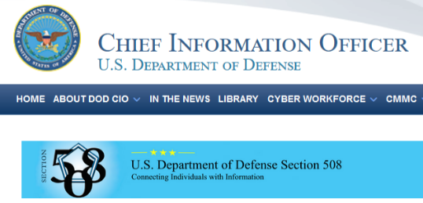


Law, Policy, Standards, and Guidelines for Cognitive Disability Accommodations
DTRA | “The Defense Threat Reduction Agency is committed to meeting or exceeding the accessibility requirements in accordance with Section 508 of the Rehabilitation Act of 1973 (29 U.S.C. § 794), as amended, in order to accommodate the widest audience, including individuals with disabilities.”
DoD CIO | “The DoD is committed to making its electronic and information technologies accessible to individuals with disabilities in accordance with Section 508 of the Rehabilitation Act.”
U.S. Access Board | “Section 508 requires access to Information & Communication Technology developed, procured, maintained, or used by federal agencies. The Section 508 Standards, which are part of the Federal Acquisition Regulation, ensure access for people with physical, sensory, or cognitive disabilities.” “Information & Communication Technology shall provide features making its use by individuals with limited cognitive, language, and learning abilities simpler and easier.” “The Revised 508 Standards and 255 Guidelines incorporate by reference the Web Content Accessibility Guidelines (WCAG) 2.0, a globally-recognized and technologically-neutral set of accessibility guidelines for Web content.”
W3C | Web Content Accessibility Guidelines (WCAG) 2.0 defines how to make Web content more accessible to people with disabilities. Accessibility involves a wide range of disabilities, including visual, auditory, physical, speech, cognitive, language, learning, and neurological disabilities. “Making Content Usable for People with Cognitive and Learning Disabilities is for people who make web content (web pages) and web applications. It gives advice on how to make content usable for people with cognitive and learning disabilities. The objectives and patterns presented here provide supplemental guidance beyond the requirements of the WCAG.”
10

Slide 11
Making Content Usable for People with Cognitive and Learning Disabilities
From: https://www.w3.org/TR/coga-usable/#summary
Notes:
Image Source: https://www.w3.org/TR/coga-usable/#summary

Slide 12
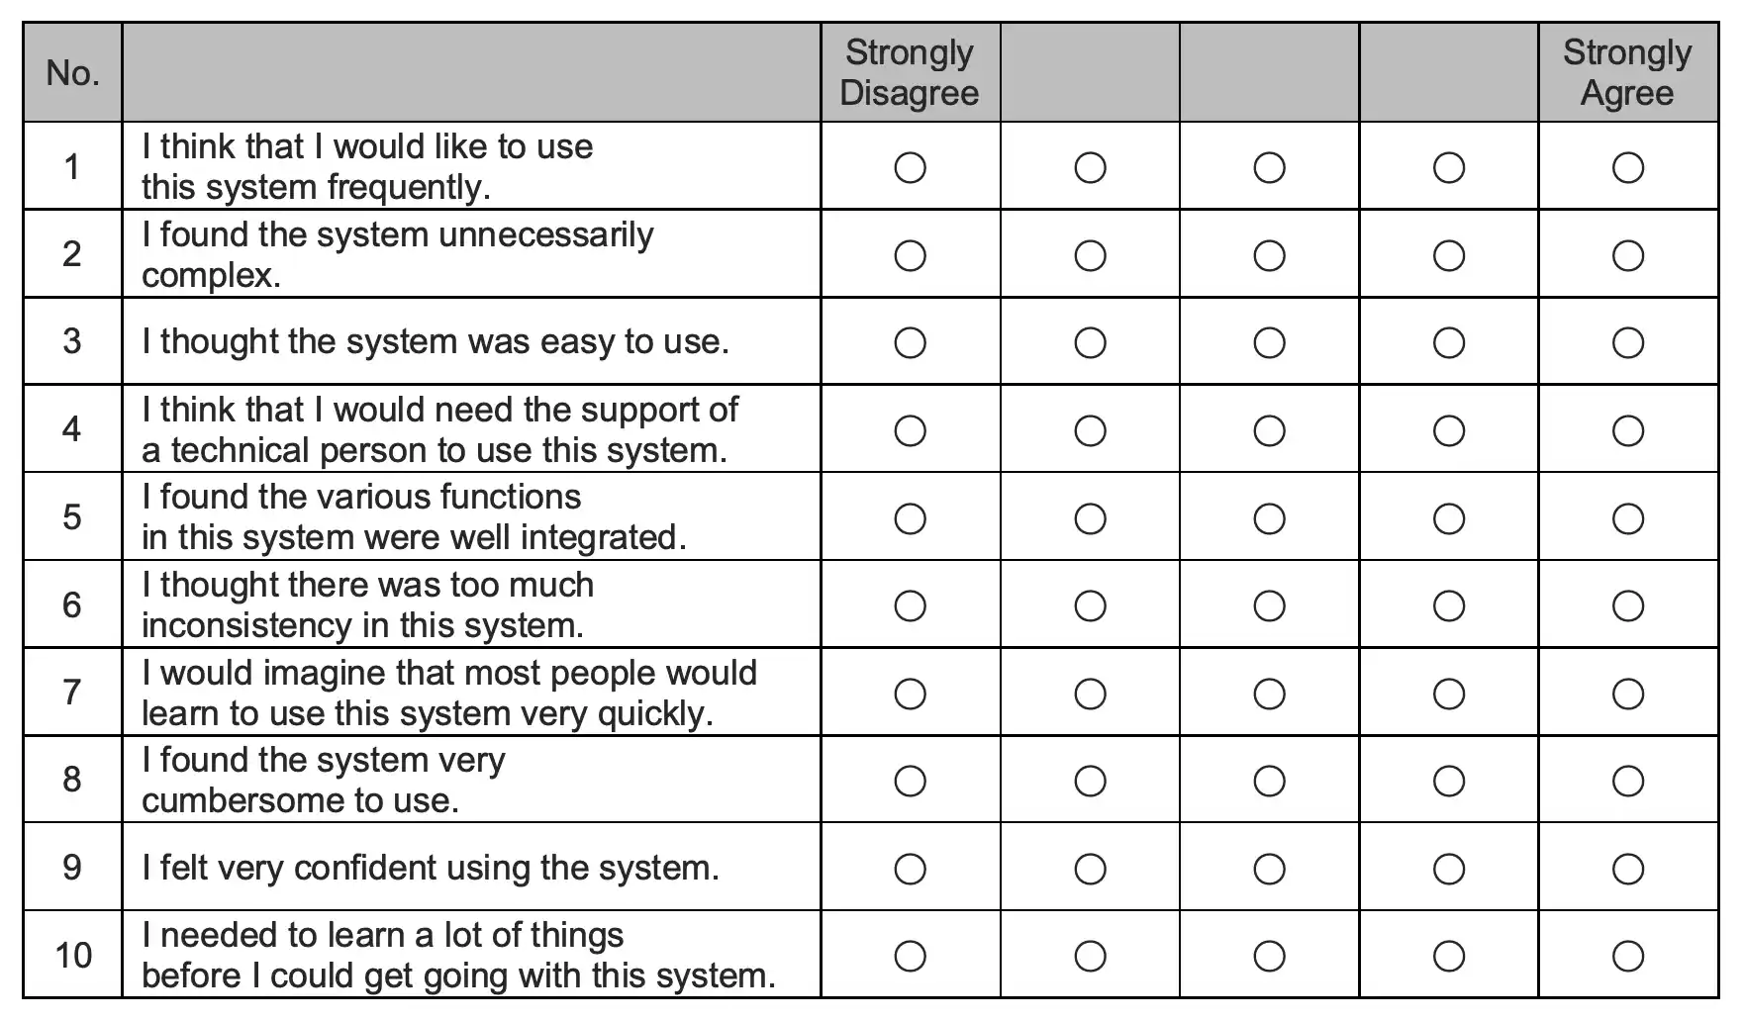
Practical Implementation via the System Usability Scale
Before release of a new internal process or system:
Require any 5 users to rate it on the System Usability Scale
Translate ratings to an A-F grade
Release if grade is C or above
Revise if grade is C- or below
Outside processes with poor usability may be documented or have other job aids made available
12

Slide 13

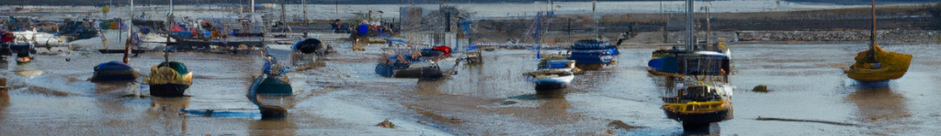
Federal Government systems need to be usable!
Require accessibility review of internal processes and systems
Require relevant contracts to address accessibility by individuals with cognitive disabilities
Educate process/system creators on usable & accessible design
Celebrate usable systems!
Usability
Certified
13
Notes:
Image Source: Generated by Gordon Banks with the assistance of DALL-E (https://openai.com/product/dall-e-2). DALL-E terms of service grant use of generated content for any purpose.

Slide 14
Usability investments pay dividends!
Better usability
Faster execution
More time
More productivity
Happier workforce
Operation Rising Tide
Gordon Banks
General Engineer
Lead, Individuals with Disabilities Employee Resource Group
Defense Threat Reduction Agency
gordon.banks9.civ@mail.mil
Kirk Shoemaker
MAJ, U.S. Army
Special Forces, FA52 (Nuclear and Countering WMD Officer)
Defense Threat Reduction Agency
kirk.m.shoemaker.mil@mail.mil
14

